Slide 1
Types of Hardware Platforms
The hardware platforms for embedded systems can be
Single board computer;
PC add-on card; or
Custom-build hardware.

Slide 2
Types of Hardware Platforms
Single board computer (SBC)
entire hardware is built on a single board.
one of the widely used hardware platforms for embedded systems.
Used if the embedded system requires high processing power
The embedded system can be built around the SBC by integrating other application specific hardware.
generally have a 32-bit/64-bit processor along with the necessary peripherals such as the memory, communication interfaces, input/output devices and if required even secondary storage such as the CDROM
can be built around processors such as x86/Pentium, PowerPC and ARM.
Internet Kiosks, Automatic Teller Machines etc. use this platform.

Slide 3
Types of Hardware Platforms
PC Add-on Cards
are plugged into the motherboard of a PC.
These cards use different types of buses for communication with the processor board. These buses are: ISA bus, PCI bus, compact PCI bus, PCMCIA bus
The PC add-on card will have application-specific hardware that includes a processor (micro-controller, microprocessor or a digital signal processor) for real-time data acquisition.
The acquired data is transferred to the PC's processor for further analysis and presentation to the user.

Slide 4
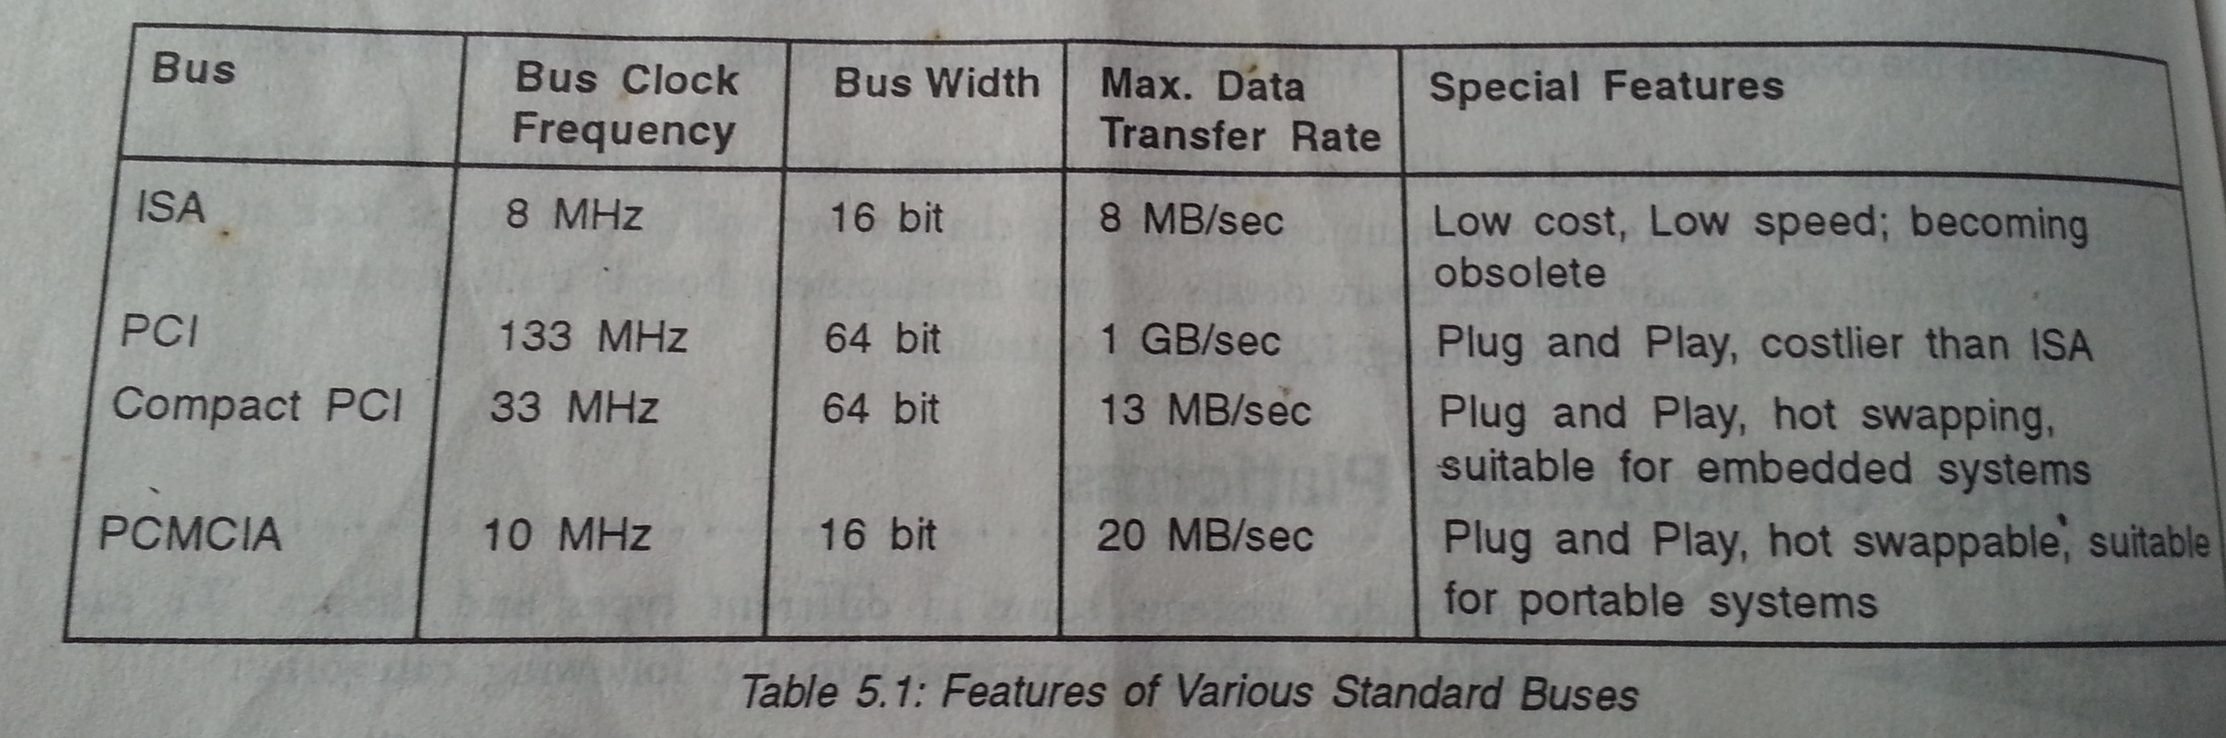

Slide 5
Types of Hardware Platforms
A few such applications are given below:
Virtual Instrumentation in which the PC add-on card is used to acquire the signals in real-time. The PC's resources (hard disk, monitor) are used for signal analysis and display.
Interactive Voice Response (IVR) systems in which the PC add-on card is used to interface with the telephone network. Any person who calls the IVR system can retrieve the information stored in the PC's database.
Software-Defined Radio (SDR) in which the radio signals are acquired in real-time. These analog signals are converted to digital format and processed through the DSP on the PC add-on card.
Telephone tapping system in which the PC add-on card captures the telephone conversation and the PC's hard disk is used to store the conversation for later analysis.
In process control systems, the PC add-on card will have multi-channel ADC chips that acquire the data from multiple sensors and transducers, and send the data to PC for analysis.

Slide 6
Types of Hardware Platforms
Custom-built Hardware platforms
Custom-built hardware platforms are used when the application demands design of a processor-based system as per the customer requirements.

Slide 7
89C51 Micro-controller Development Board
Intel 8051 family processors are widely used in small embedded systems.
ATMEL 89C51 Flash micro-controller belongs to this family.
Development board Features:
On-board 64 MB code flash and 32 KB Data RAM
RS-232 Interface
Regulated Power Supply
8 Push Buttons
8 LEDs
All I/O Ports easily accessible through Pin Header Connectors
11.059 MHz crystal
The micro-controller can be any of the MCS-51 compatible 40 Pin DIP micro-controllers.

Slide 8
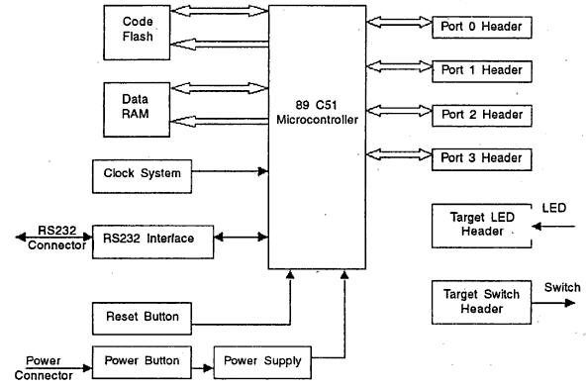
Fig1. Block Diagram of ATMEL 89C51 Development Board

Slide 9
89C51 Micro-controller Development Board
The important components used in the development board are listed below. The component reference on the PCB is given in brackets.
89C51 Micro-controller (U2)
Data Memory (U4)
Code Flash (U5)
LEDs Header (LED JP1)
Switch Header (SW JP4)
Port-0 (P0 JP2), Port-1 (PI JP3), Port-2 (A(h) JP5), Port-3 (P3 JP6) and Address Line Header (A(I)JP7)
RS232 interface (U3)

Slide 10
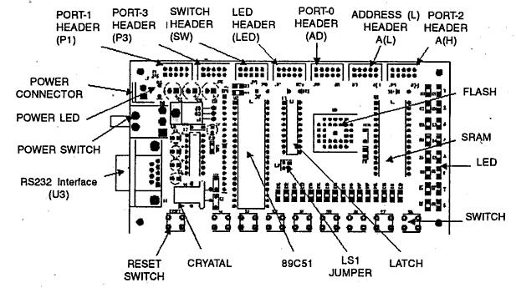
Fig2. The component layout diagram on the PCB

Slide 11
89C51 Micro-controller Development Board
89C51: It is a 40-pin DIP IC (600 mils). One can use any 40-pin DIP micro-controller of Intel 8051 family here.
Data RAM: It is a 28-pin DIP IC (600 mils). Size is 32 KB. Access time is 70 ns.
Code Flash: It is a 32-pin PLCC IC. Size is 64 KB. When you set the jumper (LSI) for the external code memory, the 89C51 fetches the code from external code Hash.
LEDs: The development board has 8 Green LEDs and 8 push-button switches. The LEDs and switches are connected to debug headers (JP1 and JP4) that are separated from the rest of the board. They can be connected with a 10-wire cable to the pin header of 89C51 I/O ports. The cables should be connected directly from the port header to the LEDs or switches. The cable should not be twisted.

Slide 12
AVR Micro-Controller Development Board
AVR microcontrollers are available with different capabilities to suit our application needs.
This family of micro-controllers can be used for tiny applications as well as large applications.
Right controller must be chosen based on the peripherals and memory requirements.

Slide 13
AVR Micro-Controller Development Board
Hardware details of a development board based on AVR ATmega128 micro-controller.
very powerful development board
can be used to develop prototype of our system and test the software.
The AVRStudio and AVR-GNU development tools provide the environment for embedded system development.
The board can be used for a variety of applications to develop prototypes to prove our design concepts.
One can also port an operating system on this board.

Slide 14
AVR Micro-Controller Development Board
Development Board features
Board is built around ATMEL AVR ATmega128-16AI micro-controller, that has RISC architecture, with maximum 16 MIPS at 16 MHz clock
Microphone input through 3.5mm Stereo Jack.
Tape / CD Input through 3.5mm Stereo Jack
Speaker Output through 3.5mm Stereo Jack
On board Data Memory 32 K x 8
Interface Connectors
All I/O Ports easily accessible through Pin Header Connectors
4 * 4 Keypad Connector

Slide 15
AVR Micro-Controller Development Board
12 * 2 LCD Connector '
RS232 Connector
USB Connector
Interrupr Connector
SPI Connector
In-System Programming (ISP) Port
General Purpose I/O
8 Push Button Inputs
8 LED Outputs
LM7805, LP3965 and LM1085 Voltage Regulators

Slide 16
AVR Micro-Controller Development Board
The AVR ATmega128 board has the feature of In-System Programming (ISP).
For ISP, the ISP port should be connected to the Parallel Port of the PC to program the internal 128 K byte Flash of ATmegal28.
Microphone, Tape/CD and speaker interface are used for voice processing applications.
User can easily access all the Ports (Port A to Port G) through 10-pin Headers.
Keypad and LCD interfaces are also provided.
The RS232 and USB connector are provided for serial communication applications.
The general purpose LED and Switch port are also provided.
The input power supply is 12 V DC, 500 mA minimum.

Slide 17
AVR Micro-Controller Development Board
The important components of this development board are as follows:
ATmega128 micro-controller (Ul)
Data Memory (U2)
8279 Keypad controller (U4)
20 Pin FRC connector tor LCD Interface
20 Pin FRC connector for Keypad Interface
USB Controller (U8)
USB connector
DAC(U13)
LEDs Header (LED)
Switch Header (SWITCH)
Port A, Port B, Port C(A(H)), Port D, Port E, Port F(ADC),

Slide 18
AVR Micro-Controller Development Board
Port G, Address Line Header (LATCH A (L)), INTERRUPT Header
MAX232 Line-Driver
RS232 Interface
Microphone-ln 3.5mm Stereo Jack
Tape/CD-In 3.5mm Stereo Jack
Speaker-Out 3.5mm Stereo Jack

Slide 19
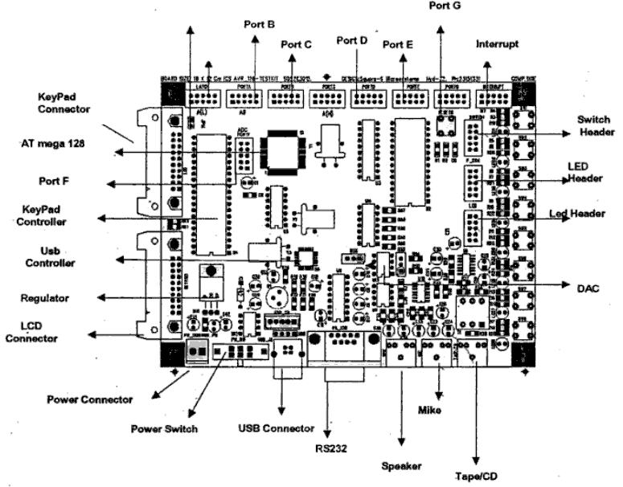
Fig8. Component Layout of AVR ATmega128 Development Board

Slide 20
AVR Micro-Controller Development Board
ATmega128 micro-controller: ATmega128 micro-controller (U1) is a 64-pin IC. Its pin connections are shown in Fig. 9.<<ATmega128 connections>>
ATmega128 is a low-power CMOS 8-bit micro-controller based on AVR enhanced RISC architecture. By executing powerful instructions in a single clock cycle, this micro-controller achieves a throughput of 16 MIPS @ 16 MHz . This micro-controller has the following features:
On-chip 128 K byte of In-systcm Programmable Flash with Read/Write capability
On-chip 4 K byte EEPROM
On-chip 4 K byte SRAM
53 General Purpose I/O lines

Slide 21
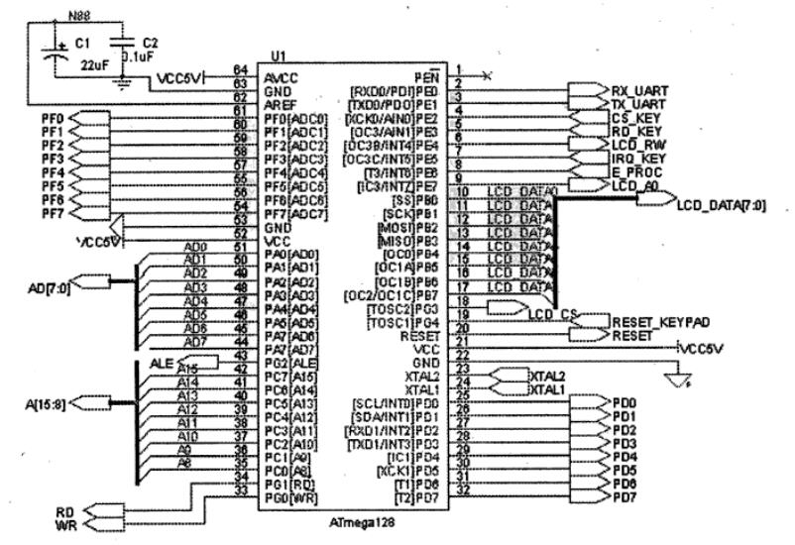
Fig9. ATmega128 Connections

Slide 22
AVR Micro-Controller Development Board
32 General Purpose Registers
Real Time Clock
Four Flexible Timers
Two-Wire Interface
8 channel ADC
Programmable Watch-dog timer
SPI Port
8 Programmable Interrupts
SRAM : It is a 28-pin DIP IC. The size of the Data RAM is 32 KB. The access time is 70 ns. The board has sufficient working memory (SRAM) to develop large application and you can also port an RTOS. Fig. 10 shows the pin connections.

Slide 23
AVR Micro-Controller Development Board
8279 Keypad Controller: It is 40-pin DIP IC used to interface with 4 * 4 keypad. The keypad is incorporated with the LEDs. Whenever the user presses any key, corresponding LED will glow. It is I/O mapped device connected to the Port B of ATmega128. The clock input is 1.8432 MHz which is internally divided by 2. The Select Lines (SL0-SL3) are used to select the Line during the scanning and it is connected to horizontal lines of keypad matrix. The Read Line (RL0-RL7) is used to connect to vertical lines of keypad matrix. The Output Lines (OUTA0-OUTA3) are used to glow the LED connected to the keypad. The pin connections are shown in Fig11.
LCD Interlace: The external 12 * 2 LCD can be interfaced as shown in Fig. 12. The LCD is I/O mapped, connected to the Port B of ATmegal28.

Slide 24
AVR Micro-Controller Development Board
Keypad interface: 20-Pin FRC (Free Ribbon Cable) connector is used to interface the keypad. The Free Ribbon Cable can be connected as shown in Fig.13.
USB Controller: The FTDI232 chip is connected for USB interface. It supports USB 1.1 version. Fig.14 shows the USB connections.
DAC: The MAX551 from Maxim is 12-bit, current-output, and 4-quadrant multiplying digital-to-analog converter (DAC). It is interfaced with the AVR through SPI interface. Data in the DAC register sets the DAC output voltage. Data is loaded into the input register via the serial interface. The LOAD input transfers data from the input register to the DAC register, updating the DAC output voltage. The DAC connections are shown in Fig15

Slide 25
AVR Micro-Controller Development Board
LEDs Header (LED): The development board includes 8 green LEDs and 8 push-button switches. The LEDs and switches are connected to debug headers (LED and Switch) that are separated from the rest of the board. They can be connected to the micro-controller through a 10-wire cable to the pin header of micro-controller I/O ports. The cable should be connected directly from the port header to the LEDs or switches. The cable should not be twisted. Fig.16 shows the LED Header interface connections.
Switch Header (SWITCH): Pushing a switch causes the corresponding signal to be pulled low, while releasing it will result in voltage on the appropriate switch header connector. The interfacing details are shown in Fig. 17

Slide 26
AVR Micro-Controller Development Board
Port A, Port B, Port C(A(H)), Port D, Port E, Port F(ADC), Port G, Address Line Header (LATCH A (L)), INTERRUPT Header: The connections for I/O port headers are shown in Fig. 18.
RS232 connector: ATmega128 has an in-built UART controller, which is connected to the RS232 line driver chip whose Tx and Rx I/O's are extended to the 9-pin D-type connector. To use RS232, the UART pins of micro-controller need be to physically connected to RS232 connector through MAX232 as shown in Fig. 5-19.
Reset Push Button: The Reset Push Button resets the micro-controller when pushed.
Main Power LED: The red LED is directly connected to the main power supply. This LED is always lit when power is applied to the board.

